Slide 1

Knowledge Discovery & Data Mining (CS 548)
Project 2
- Deepan Sanghvi, Dhaval Dholakia & Karan Napanda

Slide 2
Data Description
Dataset portrays information about a bank’s credit card clients along with their marital status, their balance limit, education, when they paid respective bill amounts.
Size: 30000 instances, 23 predictors and a response variable.
No missing values
Error in the naming of variable Pay_0, it was changed to Pay_1
Certain numeric attributes were converted to nominal.
Nominal attributes include: SEX, EDUCATION, MARRIAGE, PAY_1 to Pay_6 & default payment next month
In the education variable, the values ‘0,4,5,6’ are combined to one value as value ‘4’

Slide 3
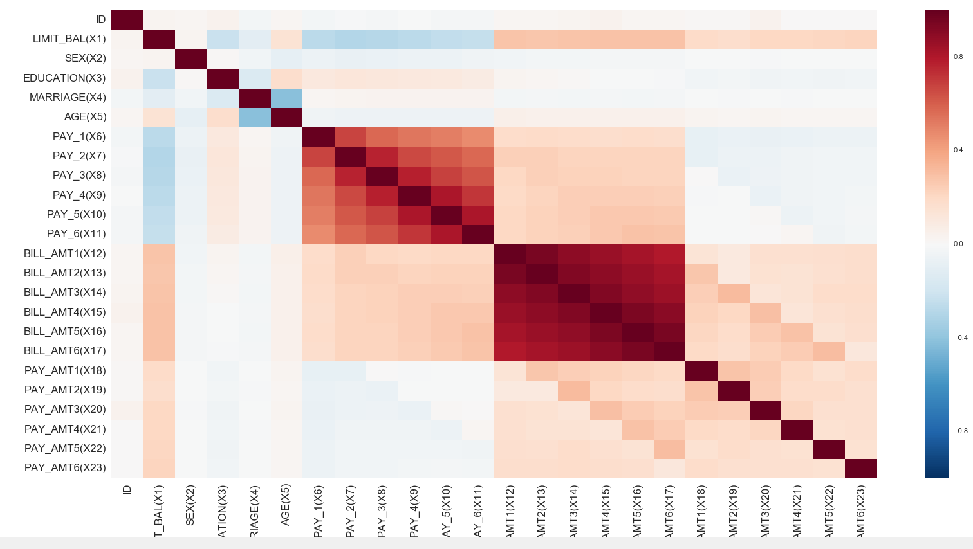
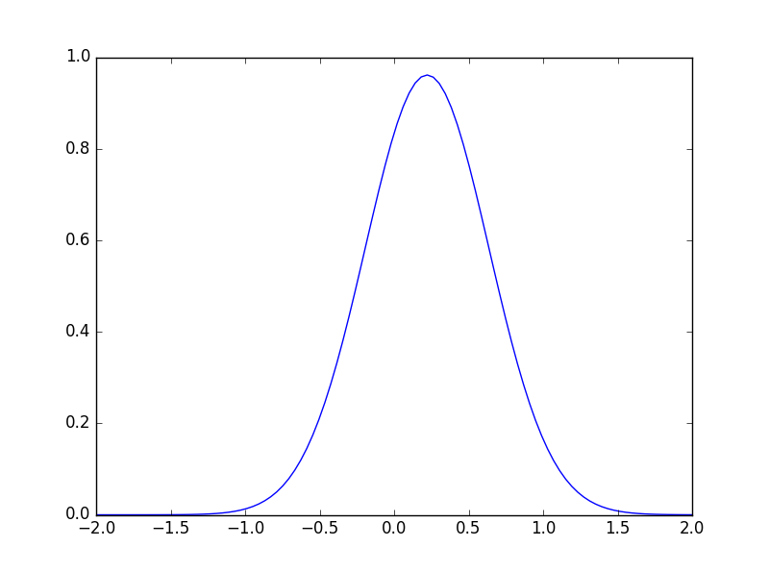
Data Exploration
All attributes have numeric set of values
The dataset is of the form (n>p) where n= number
of instances and p= number of attributes.
Skewness: 1.3435, thus it is right skewed.
Kurtosis: -0.19501, it represents a flatter distribution
compared to Gaussian distribution
Correlation Matrix of Data Set

Slide 4
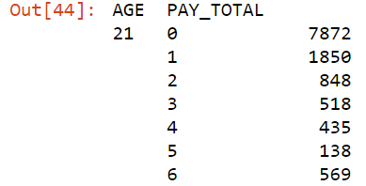
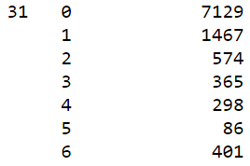
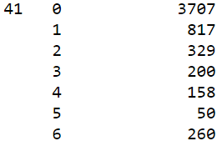
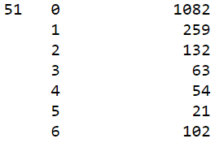
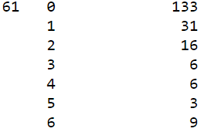
Data Exploration
A count of the number of defaults is generated against age groups
The younger age groups have been observed to default more than the other age groups.

Slide 5
Data Processing
The attribute name ‘PAY_0’ was converted to ‘PAY_1’ for naming convenience.
Numeric attributes were converted to nominal.
Values in the ‘EDUCATION’ variable was grouped such that the values ‘0,4,5,6’ was combined to one value and assigned a value ‘4’.
For all classification tasks, target variable was converted to numeric.

Slide 6
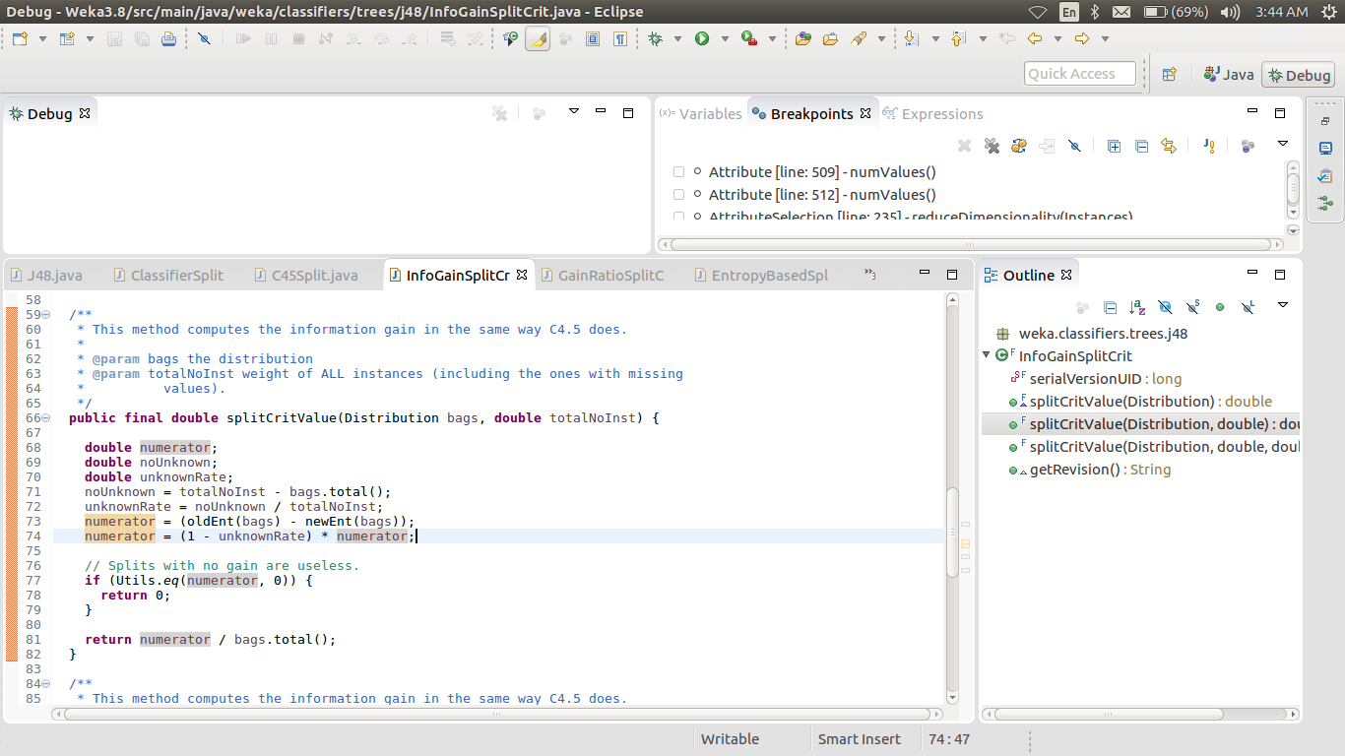
Weka Code Description (J4.8)
First, BuildTree Function is implemented
It checks whether instances belong to one class or not
Checks the basic parameters like whether the target is nominal
BuildClassifier function creates model for each attribute
For numeric data, Finds the best spit point, calculate Entropy
for each split and calculates the Information gain
Selects the best gain of all and define best split point
Info Gain= parent entropy – child entropy
Using best split point, split into subsets using Split function then recursively repeat the process
For Nominal data, it calculates the entropy for each class
InfoGain is calculated and Best gain value is selected
It checks whether the subsets have same classes and if not, recursively repeat. Else it’s a leaf node.

Slide 7
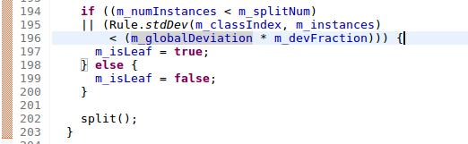
Weka Code Description (MP5 Code Description)
Calculates Standard deviation of all the observations.
Best split point is decided based on splitting criteria.
It then creates a node and further instances are distributed based on the split point. Impurity is considered for splitting too.
Instance with maximum impurity value is selected as split point.
This process is repeated iteratively.

Slide 8
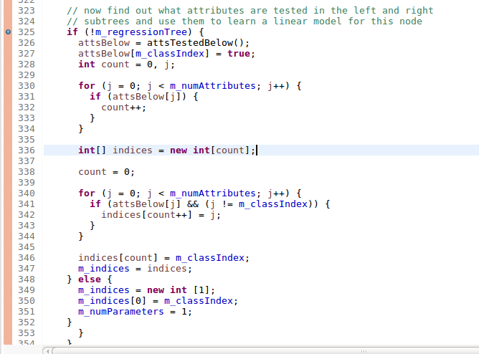
Weka Code Description (MP5 Code Description)
6. The tree is unpruned but can be used for pruning as well.
7. If “m_useunprunned” flag in WEKA is set to false, the algorithm then starts pruning the tree from the leaf nodes.
8. The model considers only attributes from the subtree below the node and creates a model using these attributes.

Slide 9
Python Packages and Functions
For Decision trees:
Packages: Sklearn (model selection, metrics, tree), Time, pandas
Functions: Kfolds, predict, score, confusion_matrix, roc_auc_score, DecisionTreeClassifier, predict_proba, export_graphviz, capacity, read
For Linear Regression:
Packages: math, sklearn (linear_model), matplotlib.pyplot
Functions: mean_squared_error, sqrt, LinearRegression, predict, score, fit, show, capacity, intercept_, read
For Regression Trees:
Packages: math, sklearn (linear_model), matplotlib.pyplot
Functions: mean_squared_error, sqrt, DecisionTreeRegressor, predict, score, fit, show, capacity, intercept_

Slide 10
Classification Experiments (Weka)
Guiding Questions
Influence of people who pay on time vs People who delays the payment in the month of September on defaulters- Hence, based on X6, one can predict whether his credit limit should be upgraded or degraded
Influence of Range of ages (age is for interpreting the results e.g. classify the results based on age groups) and history of past payment(X6-X11) on defaulters- Using age and past payment, we can find out the risk of being defaulter. Also, explained impact of CFS on accuracy and size of model
There is no Influence of Previous payment (X18-X23) on Defaulters- Even if the previous payment is bad or good enough, we cannot judge the person’s credit history just on the base of these parameters.

Slide 11
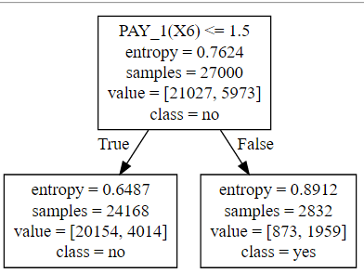
Classification Experiments (Weka)
ZeroR was used to answer the guiding question 1 & 3. Being the simples classifier, it provides a good accuracy by correctly classifying 77.77% of the instances.
OneR was used to answer the guiding question 1. Some attributes were converted to nominal and the Pay_i(i=1,2,3,4,5) attribute values were grouped.
In the first iteration it considered Pay_1 for classification. It was then removed
On the next iteration it considered Pay_2 and then after removing Pay_2 it considered Pay_5.
Thus, concluding that previous payment history mattered.
OneR Results:

Slide 12
Classification Experiments (Weka)
The 3rd guiding question is answered using J4.8. ID attributes were removed attributes X18 – X23 after finding the correlation.
Achieved a good accuracy of 81.9% thus concluding that without inclusion of past payment amounts a slightly better classification can be done but on a larger view, it did not affect the accuracy much.

Slide 13
Classification Experiments (Python)
ZeroR produced similar results compared to Weka. It considers only the majority class.
OneR was used to give a good accuracy. The attribute X6 was considered to be of importance and it was applied by categorizing its values.
J4.8 was applied to the dataset. The age attribute was discretized. ID attribute was removed. And correlation was used to select X6-X11 as they were highly correlated. It answers the 2nd guiding question accurately and concludes that payment history is significant.
J4.8 was applied again by removing the ‘ID’ attribute and the attributes X18-X23. It produced a very similar accuracy as above and the removal of attributes did not affect much.

Slide 14
Classification Experiments (Summary)
Large dataset implied good classification of both values.
If attributes are not converted to nominal, they tend create less number of leaves in the Decision Tree.
X6 being the most significant attribute, it was used for prediction by OneR as well. Thus, OneR performed well.
The attribute X6 also played a role in answering most of the guiding questions.
Thus, if X6 is removed, X7 and X10 are chosen by OneR at every iteration indicating that the ‘status/timing’ of past payments matter.
Age groups provide significant information on grouping with past payment history.
X18 – X23 were regarded redundant in most of the analysis.
OneR proved to be a surprise hero with equivalent accuracy compared to other classification; moreover, it used only 1 predictor.

Slide 15
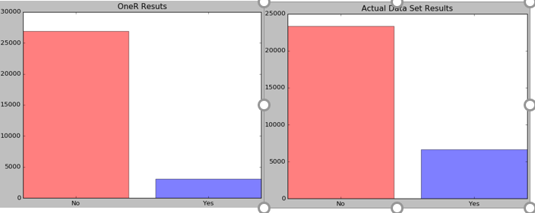
Classification Experiments (Summary)

Slide 16
Regression Experiments (Weka)
According to the client’s history of payment and the bill amount for the month of August, how well can we predict if the client is going to pay the bill for September?
How much does the payment amount for each month affect the payment of a person in the month of September?
Does the social profile (eg: Sex, Marriage and Education) and evaluation of a client matter in deciding whether that particular client will pay in September or not?

Slide 17
Regression Experiments (Weka)
Initially Linear Regression was applied to answer guiding question 1. ‘Total_Amount_Paid’ attribute was added by adding all the values of the last 6 months payments and the Bill_Amt2 attribute was also used. It was used to predict the bill amount the client will pay in September.
The M5P was also used to answer the guiding question 3. All social information was removed and M5P was applied. A correlation coefficient of close to one was achieved, thus illustrating that social profiles did not matter much in analysis.

Slide 18
Regression Experiments (Weka)
The M5P was applied to answer the guiding question 2.
All the Payment amounts were removed and it produced a high correlation coefficient.
Interestingly, one would consider it while analyzing within such a domain but the analysis comes as surprise that the payment amounts did not matter much.

Slide 19
Regression Experiments (Python)
Linear Regression effectively answers question 1. ID attribute is removed and target values are changed to ‘Yes’ and ’No’ using Pandas.replace. Total amount paid is also calculated. Payment in September is predicted and the accuracy is more or less the same. Hence, the bill of August is used to predict amount in September.
All payment amounts are removed and regression tree is applied. Accuracy is increased and the error is reduced at a good rate. Again, the previous history of payments hasn’t majorly affected the prediction.
Again, the social profiles are removed and regression tree is applied to answer guiding question 3. R² value increases and the RMSE values decreases indicating removal of social attributes for analysis was a good call of judgement.

Slide 20
Regression Experiments (Summary)
Billing of August combine by a new attribute (created by summing bills for all months) was used to predict the amount a client would pay in the month of September.
For this, the correlation coefficients made reasonable conclusions.
Also, without including social profile, linear regression predicted with similar accuracy thus indicating non-significance of the social attributes like (AGE, SEX, EDUCATION).
Linear regression had the greatest coefficient of correlation compared to the rest.

Slide 21
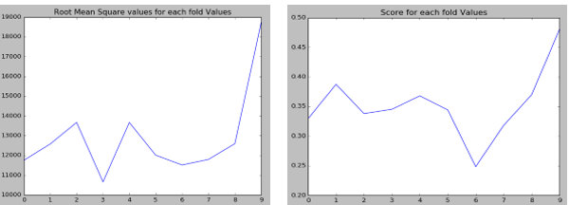
Regression Experiments (Summary)
Figure shows trend for RMS and score for each fold.
It shows how cross – validation (by selecting training and testing data) reduces error.

Slide 22
Random Forest
Random Forest is an ensemble learning algorithm.
The basic concept is that we build small number of weak decision trees with a subset of features
selected at each node and then combining these trees to form a single strong learner by either
averaging the predicted values of ith observation or taking the majority vote.
Training set is chosen at random by a random distribution vector.
Margin function is calculated on the basis of group of classifiers.
Margin function measures the extent to which average number of votes for a predicted observation for the right class exceeds the average vote for any other class. The higher the margin the more confidence in the classification.
Thus, random forest trees are constructed on the concept of bagging.
It generates ‘n’ random trees for ‘n’ random samples from bootstrapping.

Slide 23
Random Forest
At each node, “x” predictor variables are selected at random.
Random forest only considers a set of features.
It then splits on the basis of the best feature.
At the next node, another “x” predictor variables are selected at random from all predictor variables and the above process is repeated.
The test-error of this model is calculated using OOB and the average is calculated as the test error from all samples.

Slide 24
List of Resources
http://jmlr.org/proceedings/papers/v28/denil13-supp.pdf
Random Forests-Leo Breiman https://www.stat.berkeley.edu/~breiman/randomforest2001.pdf
An Introduction to Statistical Learning with applications in R - Trevor Hastie, Robert Tibshirani, Daniela Witten, Gareth James
Witten and Frank's textbook, Data Mining Practical Machine Learning Tools and Techniques

